Slide 1
Grafică asistată de calculator
Laborator – Grigore Ionuț

Slide 2
Laboratory 9
A Deep Dive into
Stable Diffusion

Slide 3
Lab Overview
01
StableDiffusionPipeline
02
Multiple prompts & parameters
Generate images from any text prompt in 3 lines using the Hugging Face diffusers library.
Generate images for 3 different prompts at once. Change resolution and guidance_scale.
03
CLIP text embeddings
04
LMS scheduler & U-Net
Manually tokenise prompts and create (1, 77, 768) text embeddings using CLIPTokenizer + CLIPTextModel.
Set up the K-LMS scheduler and the pretrained UNet2DConditionModel to denoise in the latent space.
05
gen_latents() & VAE decode
06
Text embedding interpolation
Generate 4×64×64 latent images from text embeddings, then decode to 3×512×512 final images.
Blend 'lion' and 'tiger' text embeddings at 5 weights to generate a smooth image transition sequence.

Slide 4



Stable Diffusion
open-source latent diffusion model that generates high-quality images from text prompts developed collaboratively by

Slide 5
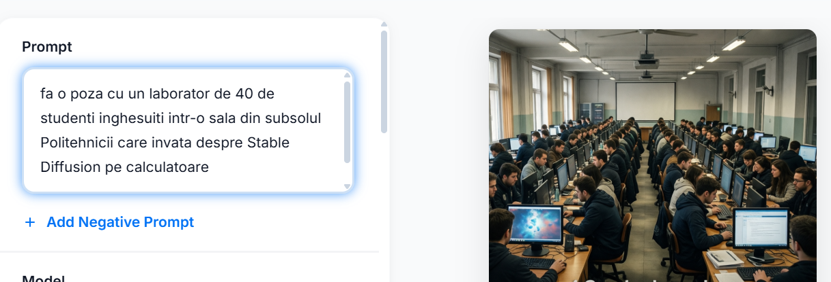

Gen…😀

Slide 6
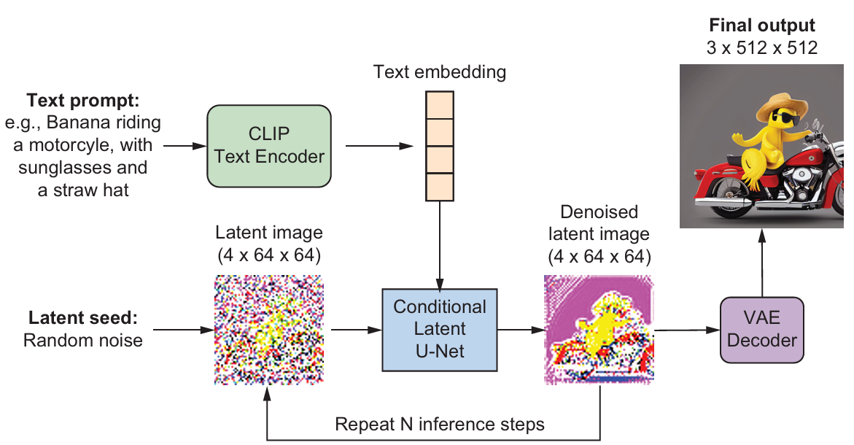
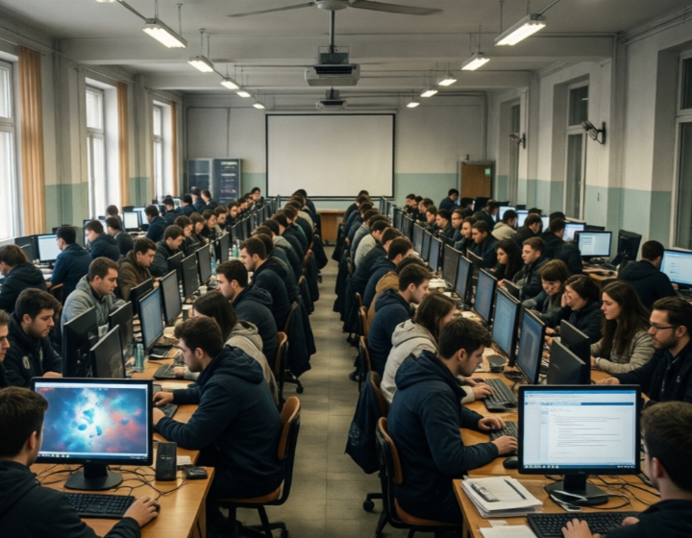
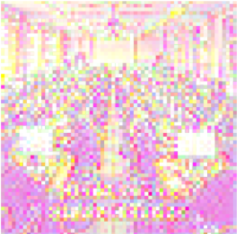








Gen…😀
fa o poza cu un laborator de 40 de studenti inghesuiti intr-o sala din subsolul Politehnicii care invata despre Stable Diffusion pe calculatoare

Slide 7
Context — Lab 8 vs Lab 9
Lab 8…

Slide 8
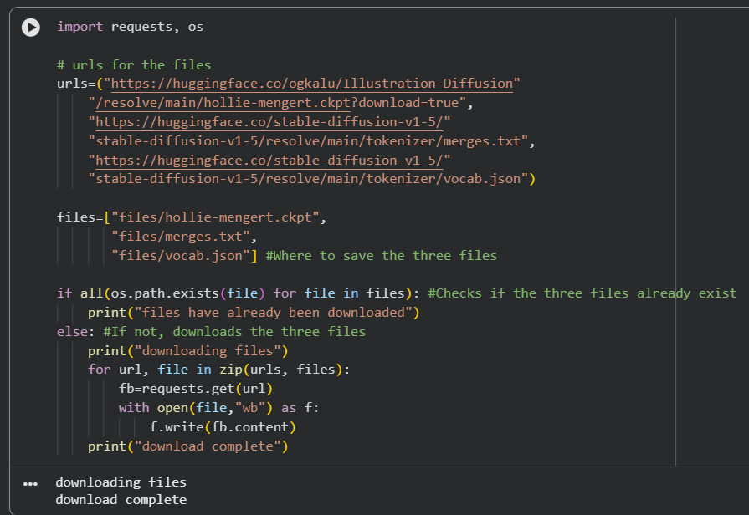

Context — Lab 8 vs Lab 9

Slide 9
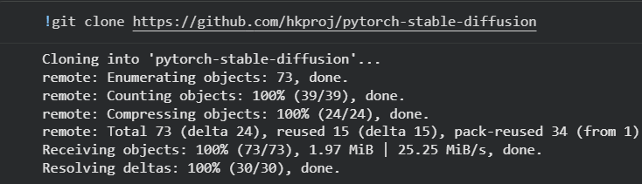

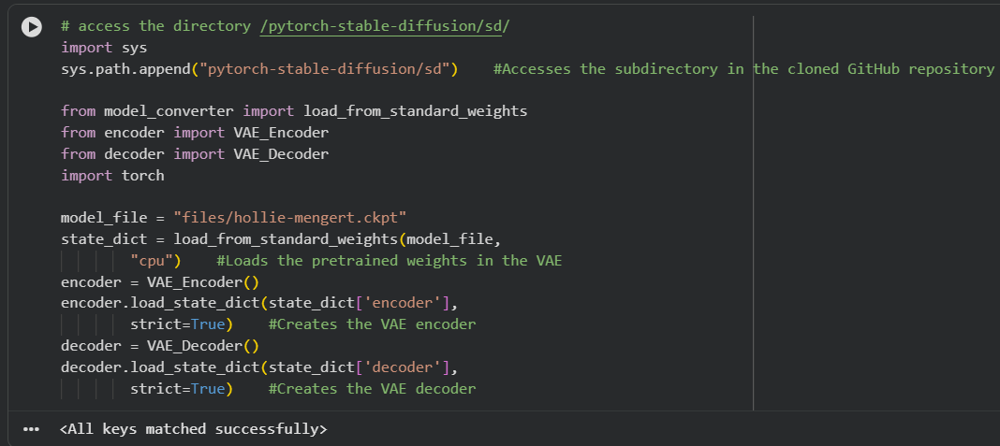
Context — Lab 8 vs Lab 9

Slide 10
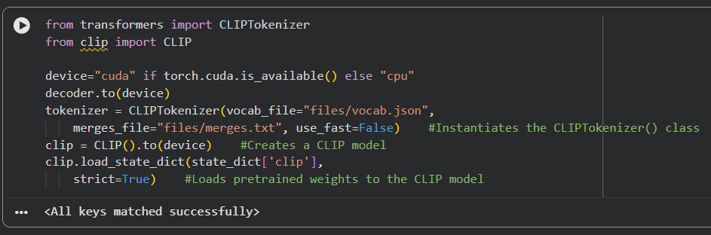

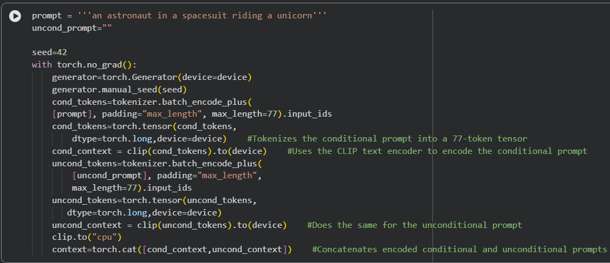
Context — Lab 8 vs Lab 9

Slide 11
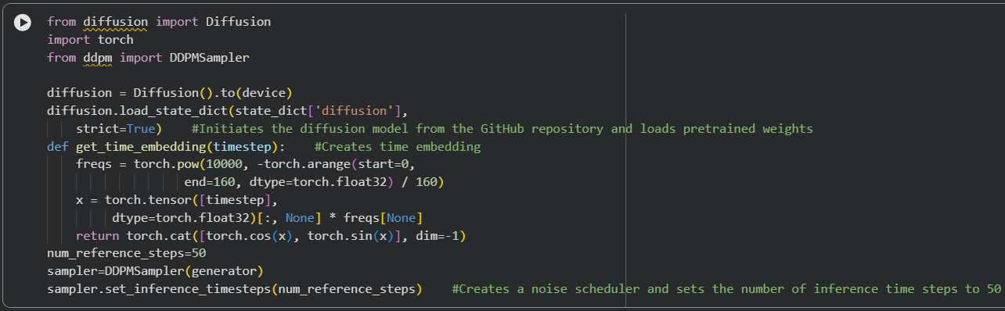

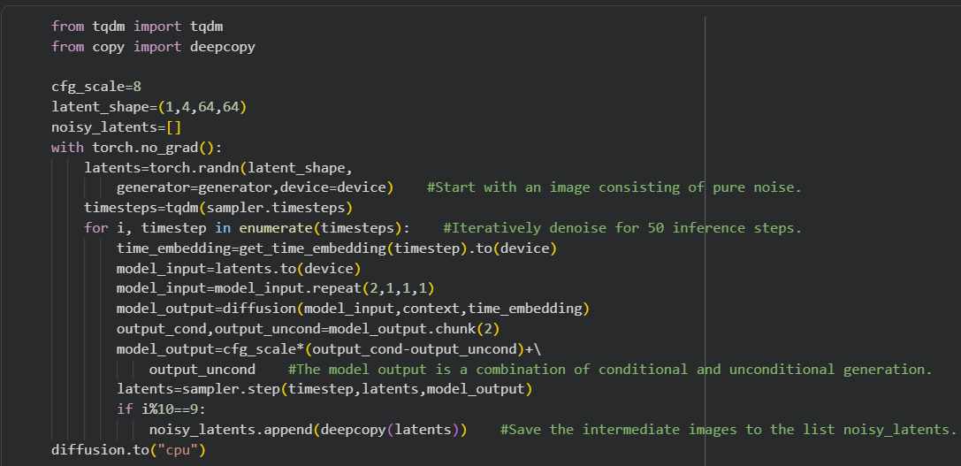
Context — Lab 8 vs Lab 9

Slide 12

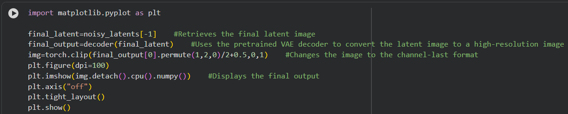
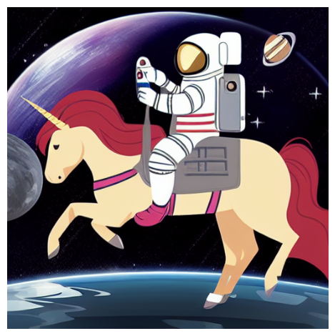
Context — Lab 8 vs Lab 9

Slide 13


For educational purposes

Slide 14
Context — Lab 8 vs Lab 9
Lab 9…

Slide 15
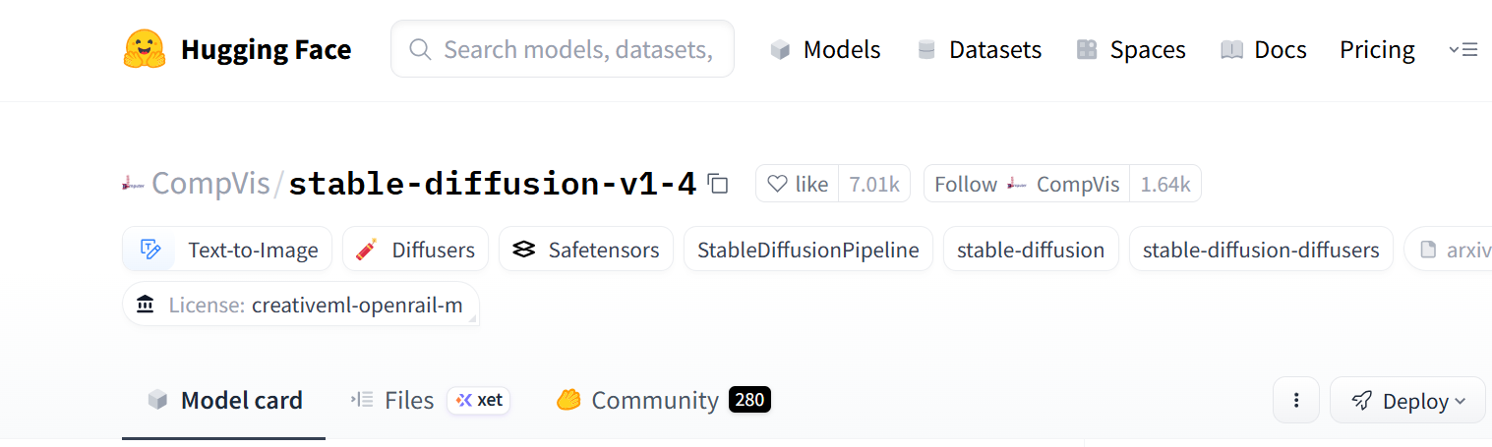
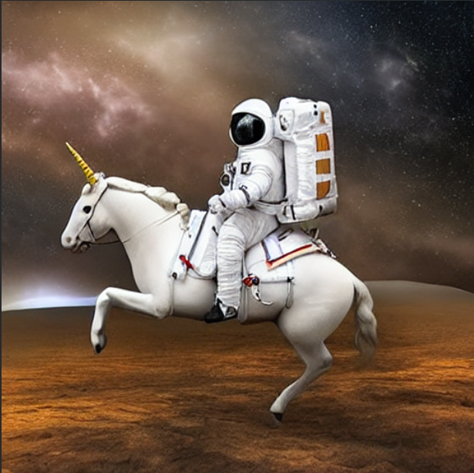
Context — Lab 8 vs Lab 9
Diffusers is a Hugging Face library for diffusion models.
import torch
from diffusers import StableDiffusionPipeline
torch.manual_seed(42)
prompt="an astronaut in a spacesuit riding a unicorn"
pipe = StableDiffusionPipeline.from_pretrained("CompVis/stable-diffusion-v1-4", variant="fp16", torch_dtype=torch.float16).to("cuda")
image = pipe(prompt).images[0]
One class handles everything: tokenization, CLIP text encoder, U-Net, VAE, image generation

Slide 16
Section 1
Generating Images
with the
diffusers Library

Slide 17

We can do many things with diffusers library

Slide 18
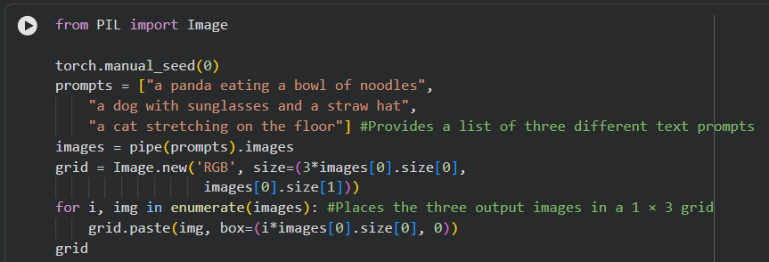
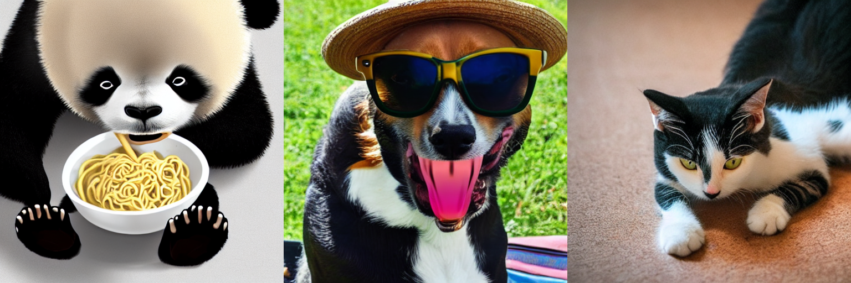
Multiple Prompts and Adjusting Parameters
We can generate multiple images at once using different prompts:

Slide 19
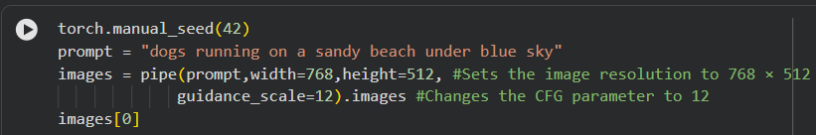
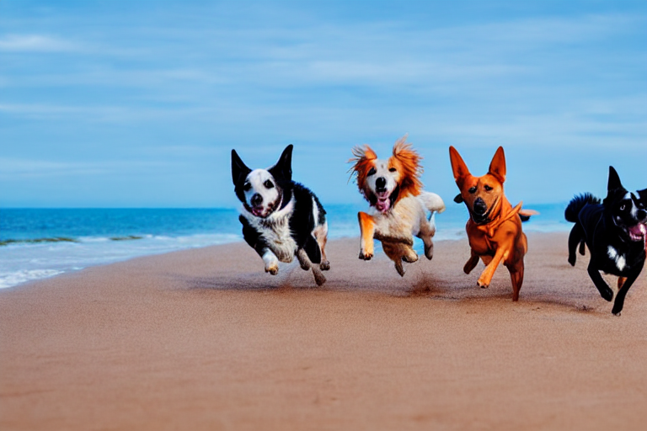
Multiple Prompts and Adjusting Parameters
We can change the image resolution and classifier-free guidance parameter:

Slide 20

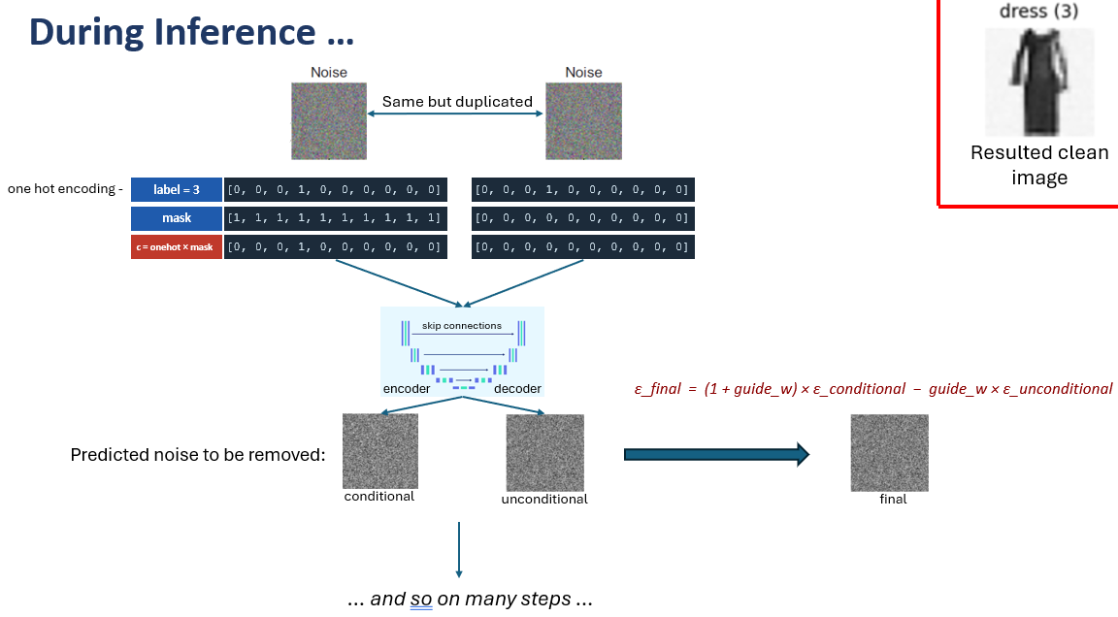
What is classifier-free guidance or guidance scale
Remember this from lab 5 ?

Slide 21
Section 2
Creating CLIP
Text Embeddings
Manually

Slide 22

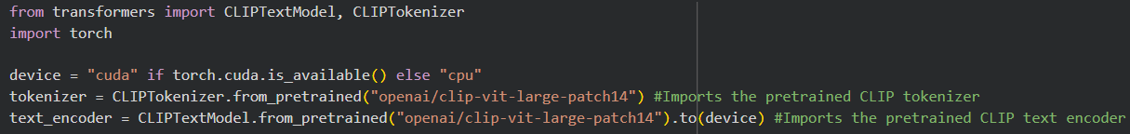
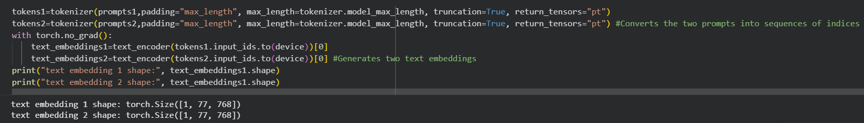
CLIPTokenizer and CLIPTextModel
Defining text prompts:
Setting up CLIP tokenizer and text encoder:
Tokenizing prompts and generating text embeddings:
Creating the unconditional embedding:

Slide 23
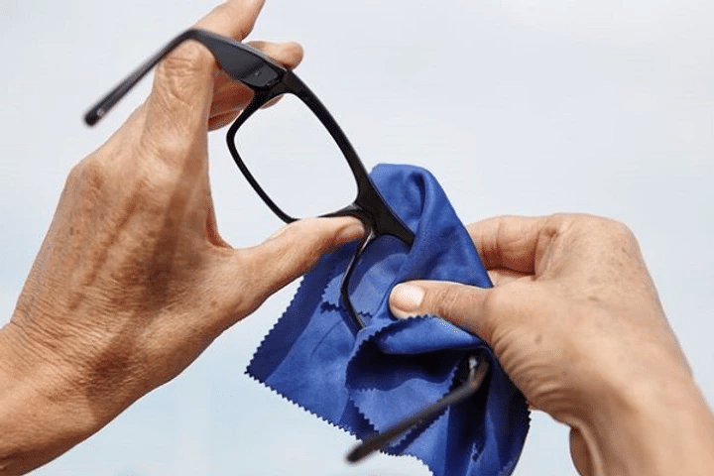

Slide 24
conditional prompt
unconditional prompt
conditional prompt
“a lion"
""
“a tiger"
CLIP Tokeniser
CLIP Tokeniser
CLIP Tokeniser
…
…
…
vector with 77 elements
vector with 77 elements
vector with 77 elements
CLIP Text Encoder
shape (1, 77, 768)
shape (1, 77, 768)
shape (1, 77, 768)
…
…
…
…
…
…
…
…
…
conditional context1
unconditional context
conditional context2
context1 = concat([conditional context1, unconditional context])
shape (2, 77, 768)
context2 = concat([conditional context2, unconditional context])
shape (2, 77, 768)

Slide 25
Section 3
Latent Space
Generation:
gen_latents()

Slide 26
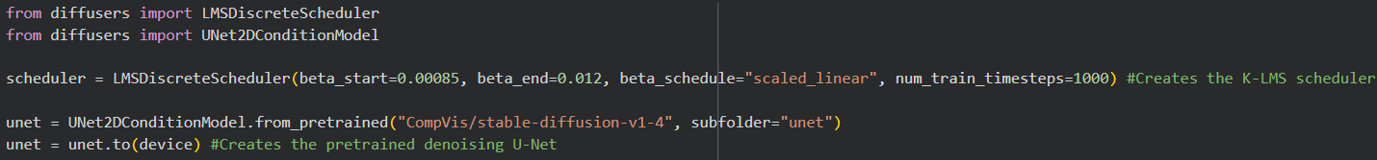
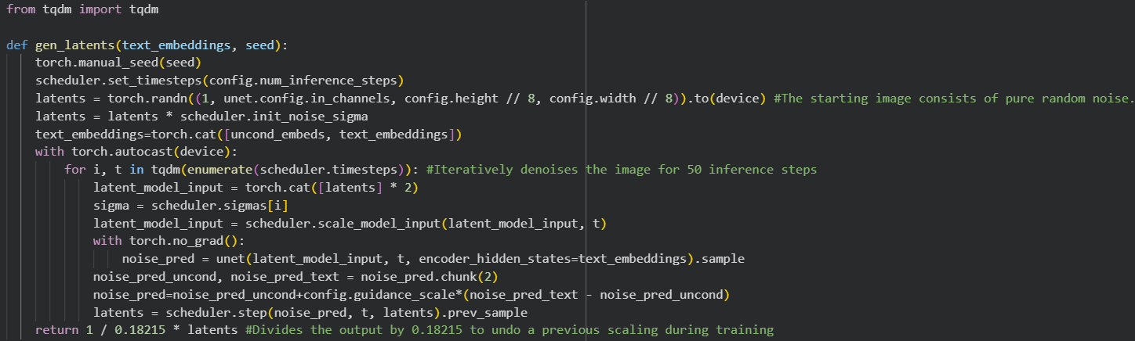
Initializing the scheduler and denoising U-Net:
Generating and iteratively denoising latent noise:

Slide 28
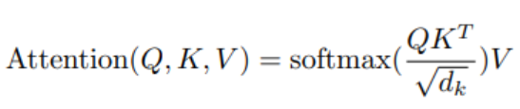
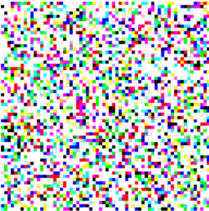
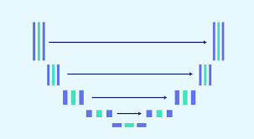
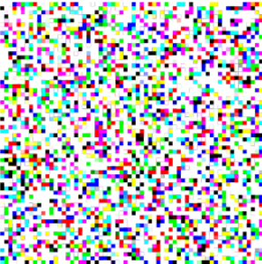
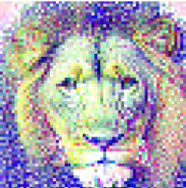
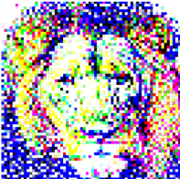
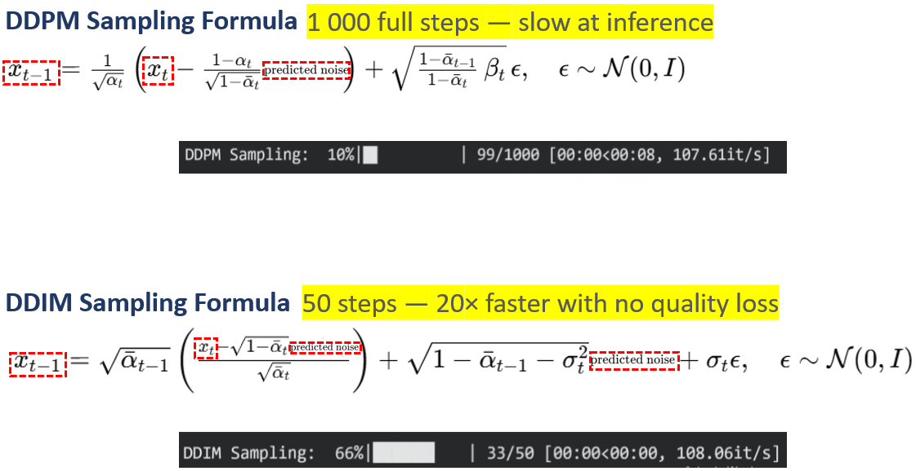

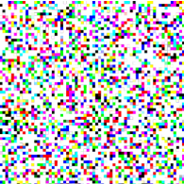

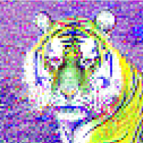
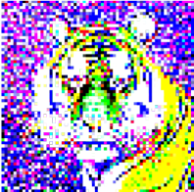
context1
skip connections
skip connections
…
skip connections
encoder
decoder
encoder
decoder
encoder
decoder
UNet's actual output is the predicted noise, not the clean image. The cleaning is done by subtracting that noise from the input using either the DDPM or DDIM formula. What is shown here after each step is the already-denoised result.
context2
skip connections
skip connections
…
skip connections
encoder
decoder
encoder
decoder
encoder
decoder

Slide 29
Section 4
VAE Decode &
Text Embedding
Interpolation

Slide 30

VAE Decode: Latent → 512×512 Image
Loading the VAE decoder:
Decoding latents into images:

Slide 32
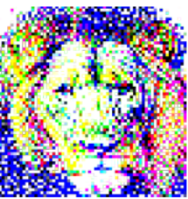
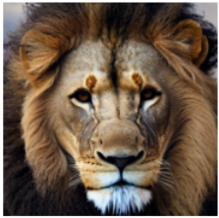
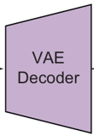


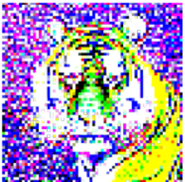
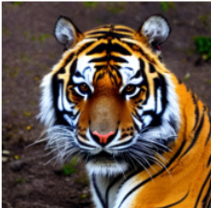
VAE Decode: Latent → 512×512 Image

Slide 33
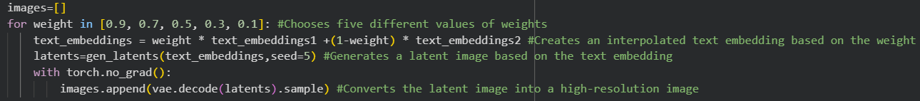
Text Embedding Interpolation
Blend two text embeddings at different weights to generate a smooth visual transition between subjects:

Slide 35
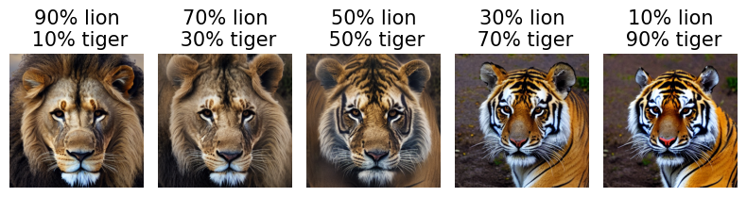
Text Embedding Interpolation
context
skip connections
skip connections
…
skip connections
encoder
decoder
encoder
decoder
encoder
decoder
NOTE:
The output images are generated by blending two text embeddings before passing them to the diffusion process:
text_embeddings = w·emb("lion") + (1−w)·emb("tiger")
Each image corresponds to a different weight w, smoothly interpolating between the two prompts.
VAE Decoder

Slide 36
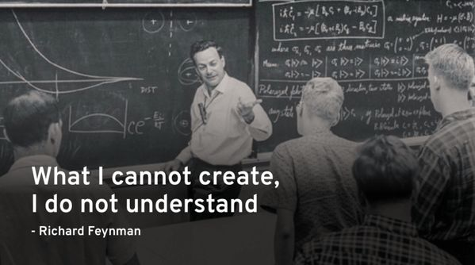

Slide 37
Exercises
01
Change prompt to 'a futuristic city at sunrise'
02
Define prompt3='a leopard', prompt4='a lioness'
Replace the prompt in the StableDiffusionPipeline code. Rerun the cell and observe how the model renders a city scene at sunrise.
Tokenise both prompts using CLIPTokenizer with padding='max_length', max_length=77, truncation=True. Convert to text_embeddings3 and text_embeddings4 using CLIPTextModel.
Hint: Just change one string: prompt='a futuristic city at sunrise'. Keep seed=42 for reproducibility.
Hint: Same code as the lion/tiger section — only the prompt strings change. Both embeddings have shape (1, 77, 768).
03
gen_latents() on text_embeddings3 & text_embeddings4 (seed=8)
04
Decode latents3 & latents4 → images3, images4
Apply gen_latents() to both embeddings with seed=8. Name the results latents3 and latents4. Print the latent shape.
Use the pretrained VAE to convert both latent images to high-resolution images. Name them images3 and images4.
Hint: latents3=gen_latents(text_embeddings3, seed=8). Expected shape: (1, 4, 64, 64) or (4, 64, 64) depending on implementation.
Hint: images3 = vae.decode(latents3).sample. images4 = vae.decode(latents4).sample. Each has shape (1, 3, 512, 512).
05
Plot latents3, images3, latents4, images4 in 1×4 grid
06
Interpolate text_embeddings3 & text_embeddings4 at 5 weights
Place all four in a list. Use latent_to_display_image() for the latents and output_to_display_image() for the decoded images. Label each subplot.
weights=[0.9, 0.7, 0.5, 0.3, 0.1]. For each weight: blend embeddings, gen_latents(seed=5), decode with VAE. Plot 5 images in 1×5 grid with % labels.
Hint: plt.subplot(1, 4, i+1). Labels: 'leopard latent', 'leopard image', 'lioness latent', 'lioness image'.
Hint: Same loop as the lion/tiger section. title=f'{int(w*100)}% leopard\n{int((1-w)*100)}% lioness'.

Slide 38
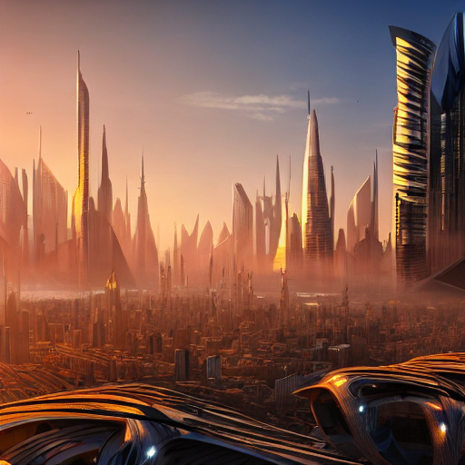
Ex 1
Change prompt to 'a futuristic city at sunrise'
❓ Change the text prompt to “a futuristic city at sunrise” in the image generation with the diffusers library code. Rerun the code to see the generated image.
import torch
from diffusers import StableDiffusionPipeline
torch.manual_seed(42)
prompt = "a futuristic city at sunrise" # ← only change from section 1
pipe = StableDiffusionPipeline.from_pretrained("CompVis/stable-diffusion-v1-4", variant="fp16", torch_dtype=torch.float16).to("cuda")
image = pipe(prompt).images[0]
image

Slide 39
Ex 2
Define prompt3='a leopard', prompt4='a lioness'
❓ Define prompt3 and prompt4 as “a leopard” and “a lioness”, respectively. Then tokenize the two prompts, and convert them to text embeddings, text_embedding3 and text_embedding4.
from transformers import CLIPTextModel, CLIPTokenizer
import torch
device = "cuda" if torch.cuda.is_available() else "cpu"
# Load CLIP components
tokenizer = CLIPTokenizer.from_pretrained("openai/clip-vit-large-patch14")
text_encoder = CLIPTextModel.from_pretrained("openai/clip-vit-large-patch14").to(device)
# Define prompts
prompt3 = ["a leopard"]
prompt4 = ["a lioness"]
# Tokenise — padding to 77 tokens, truncate if longer
tokens3 = tokenizer(prompt3, padding="max_length", max_length=tokenizer.model_max_length, truncation=True, return_tensors="pt")
tokens4 = tokenizer(prompt4, padding="max_length", max_length=tokenizer.model_max_length, truncation=True, return_tensors="pt")
# Encode with CLIP text encoder
with torch.no_grad():
text_embeddings3 = text_encoder(tokens3.input_ids.to(device))[0]
text_embeddings4 = text_encoder(tokens4.input_ids.to(device))[0]
print("text_embeddings3 shape:", text_embeddings3.shape)
print("text_embeddings4 shape:", text_embeddings4.shape)
Expected output text_embeddings3 shape: torch.Size([1, 77, 768])
text_embeddings4 shape: torch.Size([1, 77, 768]) — same shape as lion/tiger embeddings.

Slide 40
Ex 3
gen_latents() on text_embeddings3 & text_embeddings4 (seed=8)
❓ Apply the gen_latents() function on the two text embeddings text_embedding3 and text_embedding4, which were generated earlier. Set the seed value to 8. Name the latent images latents3 and latents4.
latents3 = gen_latents(text_embeddings3, seed=8) # seed=8 as specified
latents4 = gen_latents(text_embeddings4, seed=8)
print(f"latent image size: {latents3[0].shape}")
Expected output latent image size: torch.Size([4, 64, 64])

Slide 41
Ex 4
Decode latents3 & latents4 → images3, images4
❓ Convert the two latent images, latents3 and latents4, into high-resolution images. Name them images3 and images4, respectively.
from diffusers import AutoencoderKL
# Load pretrained VAE (reuse if already loaded in section 4)
vae = AutoencoderKL.from_pretrained("CompVis/stable-diffusion-v1-4", subfolder="vae").to(device)
with torch.no_grad():
images3 = vae.decode(latents3).sample
images4 = vae.decode(latents4).sample
print(f"final image size: {images3[0].shape}")
Expected output final image size: torch.Size([3, 512, 512])

Slide 42
Ex 5
Plot latents3, images3, latents4, images4 in 1×4 grid
❓ Plot the two latent images, latents3 and latents4, and the two outputs, images3 and images4, in a 1×4 grid. Label the four images accordingly.
import matplotlib.pyplot as plt
import numpy as np
# Helper functions from section 4 of the lab
def latent_to_display_image(latent, upsample_factor=8):
image = latent[0].permute(1, 2, 0).detach().cpu()
image = torch.clamp(image, -1, 1)
image = image.repeat_interleave(upsample_factor, dim=0).repeat_interleave(upsample_factor, dim=1)
return ((image + 1) / 2).numpy()
def output_to_display_image(output):
image = output[0].permute(1, 2, 0).detach().cpu()
return torch.clamp((image + 1) / 2, 0, 1).numpy()
# 1×4 grid
imgs = [
latent_to_display_image(latents3), # leopard latent (upsampled ×8)
output_to_display_image(images3), # leopard decoded image
latent_to_display_image(latents4), # lioness latent (upsampled ×8)
output_to_display_image(images4), # lioness decoded image
]
labels = ["leopard latent", "leopard image", "lioness latent", "lioness image"]
plt.figure(figsize=(12, 3), dpi=100)
for i in range(4):
plt.subplot(1, 4, i + 1)
plt.imshow(imgs[i])
plt.title(labels[i], fontsize=11)
plt.axis("off")
plt.tight_layout()
plt.show()

Slide 43
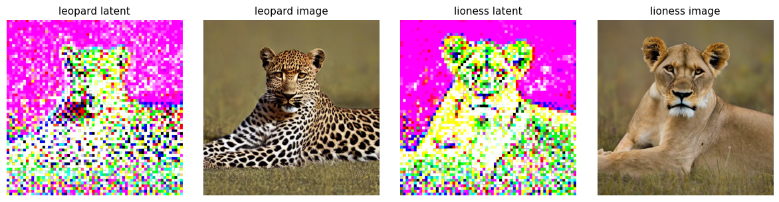
Ex 5
Plot latents3, images3, latents4, images4 in 1×4 grid
❓ Plot the two latent images, latents3 and latents4, and the two outputs, images3 and images4, in a 1×4 grid. Label the four images accordingly.

Slide 44
Ex 6
Interpolate text_embeddings3 & text_embeddings4 at 5 weights
❓ Let the variable weight take five values, 0.9, 0.7, 0.5, 0.3, and 0.1. Create five interpolated text embeddings of text_embeddings3 and text_embeddings4 based on these weights. Feed the interpolated text embeddings to the gen_latents() function to generate five latent images. Convert the five latent images to high-resolution ones using the VAE decoder. Plot the five high-resolution images in a 1×5 grid, and label them accordingly.
import torch
import matplotlib.pyplot as plt
images_interp = []
for weight in [0.9, 0.7, 0.5, 0.3, 0.1]:
# Blend the two embeddings: weight on leopard, (1-weight) on lioness
text_embeddings = weight * text_embeddings3 + (1 - weight) * text_embeddings4
# Generate latent with same seed=5 (keeps composition consistent)
latents = gen_latents(text_embeddings, seed=5)
# Decode latent to 512×512 image
with torch.no_grad():
images_interp.append(vae.decode(latents).sample)
# Plot the 5 interpolated images
plt.figure(figsize=(12, 3), dpi=100)
for i in range(5):
plt.subplot(1, 5, i + 1)
img = torch.clip(images_interp[i][0].detach().cpu().permute(1, 2, 0) / 2 + 0.5, 0, 1)
plt.imshow(img)
pct_l = int((0.9 - i * 0.2) * 100)
pct_t = 100 - pct_l
plt.title(f"{pct_l}% leopard\n{pct_t}% lioness", fontsize=11)
plt.axis("off")
plt.tight_layout()
plt.show()

Slide 45
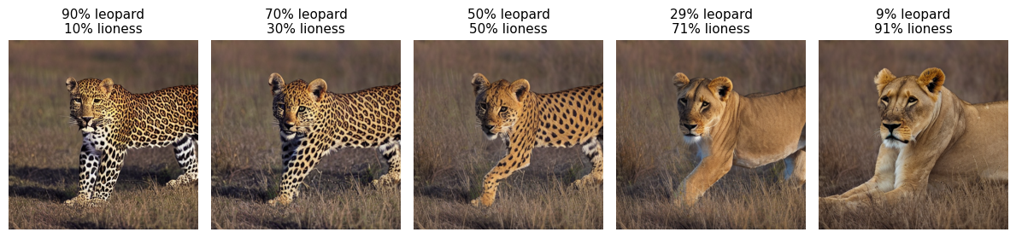
Ex 6
Interpolate text_embeddings3 & text_embeddings4 at 5 weights
❓ Let the variable weight take five values, 0.9, 0.7, 0.5, 0.3, and 0.1. Create five interpolated text embeddings of text_embeddings3 and text_embeddings4 based on these weights. Feed the interpolated text embeddings to the gen_latents() function to generate five latent images. Convert the five latent images to high-resolution ones using the VAE decoder. Plot the five high-resolution images in a 1×5 grid, and label them accordingly.

Slide 46
Thank you !

